Slide 1
Notes:
original slide show from: https://github.com/rstudio-education/master-the-tidyverse-instructors/tree/master/powerpoints
modified 2019-10-16 by Kim Cressman to incorporate pivot() functions and shorten for CERF workshop

Slide 2
"Data comes in many formats, but R prefers just one: tidy data. "
- Garrett Grolemund

Slide 3

Tidy data
country | year | cases | pop
Afghanistan | 1999 | 745 | 19987071
Afghanistan | 2000 | 2666 | 20595360
Brazil | 1999 | 37737 | 172006362
Brazil | 2000 | 80488 | 174504898
China | 1999 | 212258 | 1272915272
China | 2000 | 213766 | 1280428583
A data set is tidy iff:
Each variable is in its own column
Each observation is in its own row
Each value is in its own cell
Also see these papers, in your “other resources” folder:
Wickham, 2014: Tidy Data
Broman and Woo, 2017: Data Organization in Spreadsheets

Slide 4
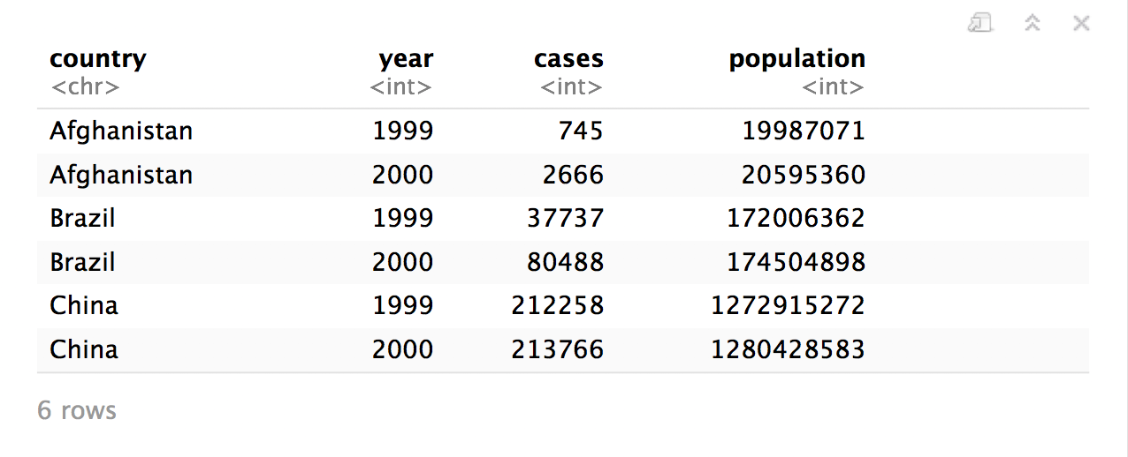
Quiz
What are the variables in this data set?
table1

Slide 5
Tidy data
country | year | cases | pop
Afghanistan | 1999 | 745 | 19987071
Afghanistan | 2000 | 2666 | 20595360
Brazil | 1999 | 37737 | 172006362
Brazil | 2000 | 80488 | 174504898
China | 1999 | 212258 | 1272915272
China | 2000 | 213766 | 1280428583
A data set is tidy iff:
Each variable is in its own column
Each observation is in its own row
Each value is in its own cell
variable: all values that measure the same underlying attribute
observation: all values measured on the same unit
value: belongs to one variable and one observation

Slide 6
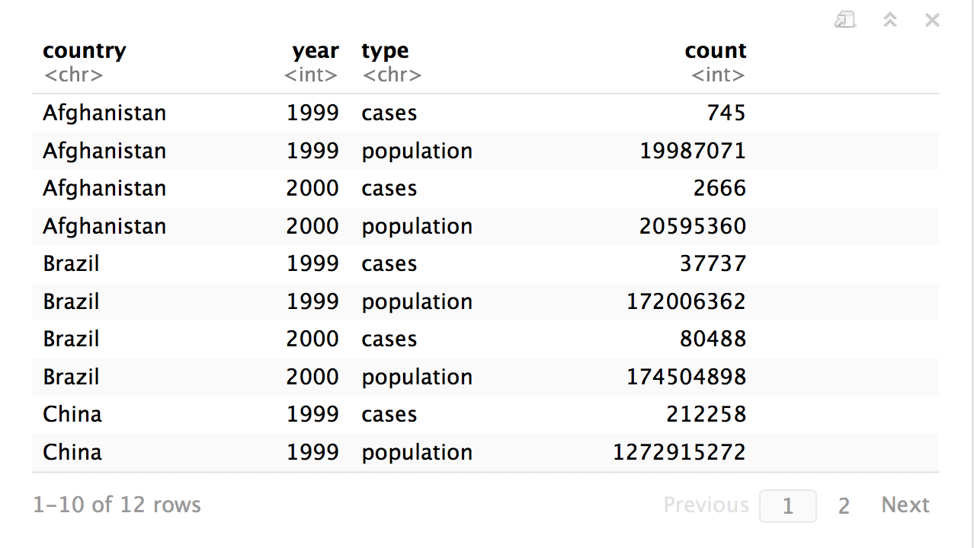
Quiz
What are the variables in this data set?
table2
Notes:
tables 1, 2, 3, 4a, 4b, and 5 are all built-in datasets in R. They are different ways of representing the same data and are subsets from World Health Organization Tuberculosis data between 1999-2000.

Slide 7
Tidy data
country | year | cases | pop
Afghanistan | 1999 | 745 | 19987071
Afghanistan | 2000 | 2666 | 20595360
Brazil | 1999 | 37737 | 172006362
Brazil | 2000 | 80488 | 174504898
China | 1999 | 212258 | 1272915272
China | 2000 | 213766 | 1280428583
A data set is tidy iff:
Each variable is in its own column
Each observation is in its own row
Each value is in its own cell

Slide 8
table1$country
table1$year
table1$cases
table1$population

Slide 9


table2$country
table2$year
table2$count[c(1,3,5,7,9,11)]
table2$count[c(2,4,6,8,10,12)]

Slide 10
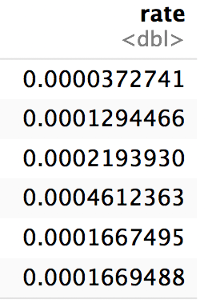
table1$cases / table1$population -> table1$rate

Slide 11
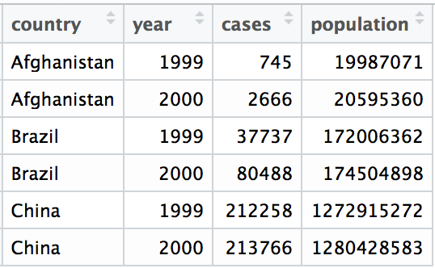
Tidy data
A data set is tidy iff:
Each variable is in its own column
Each case is in its own row
Each value is in its own cell

Slide 12
"Tidy data sets are all alike; but every messy data set is messy in its own way."
- Hadley Wickham

Slide 13

tidyr

Slide 14
tidyr
A package that reshapes the layout of tabular data.
CC BY-SA RStudio

Slide 15
pivot_longer()

Slide 16
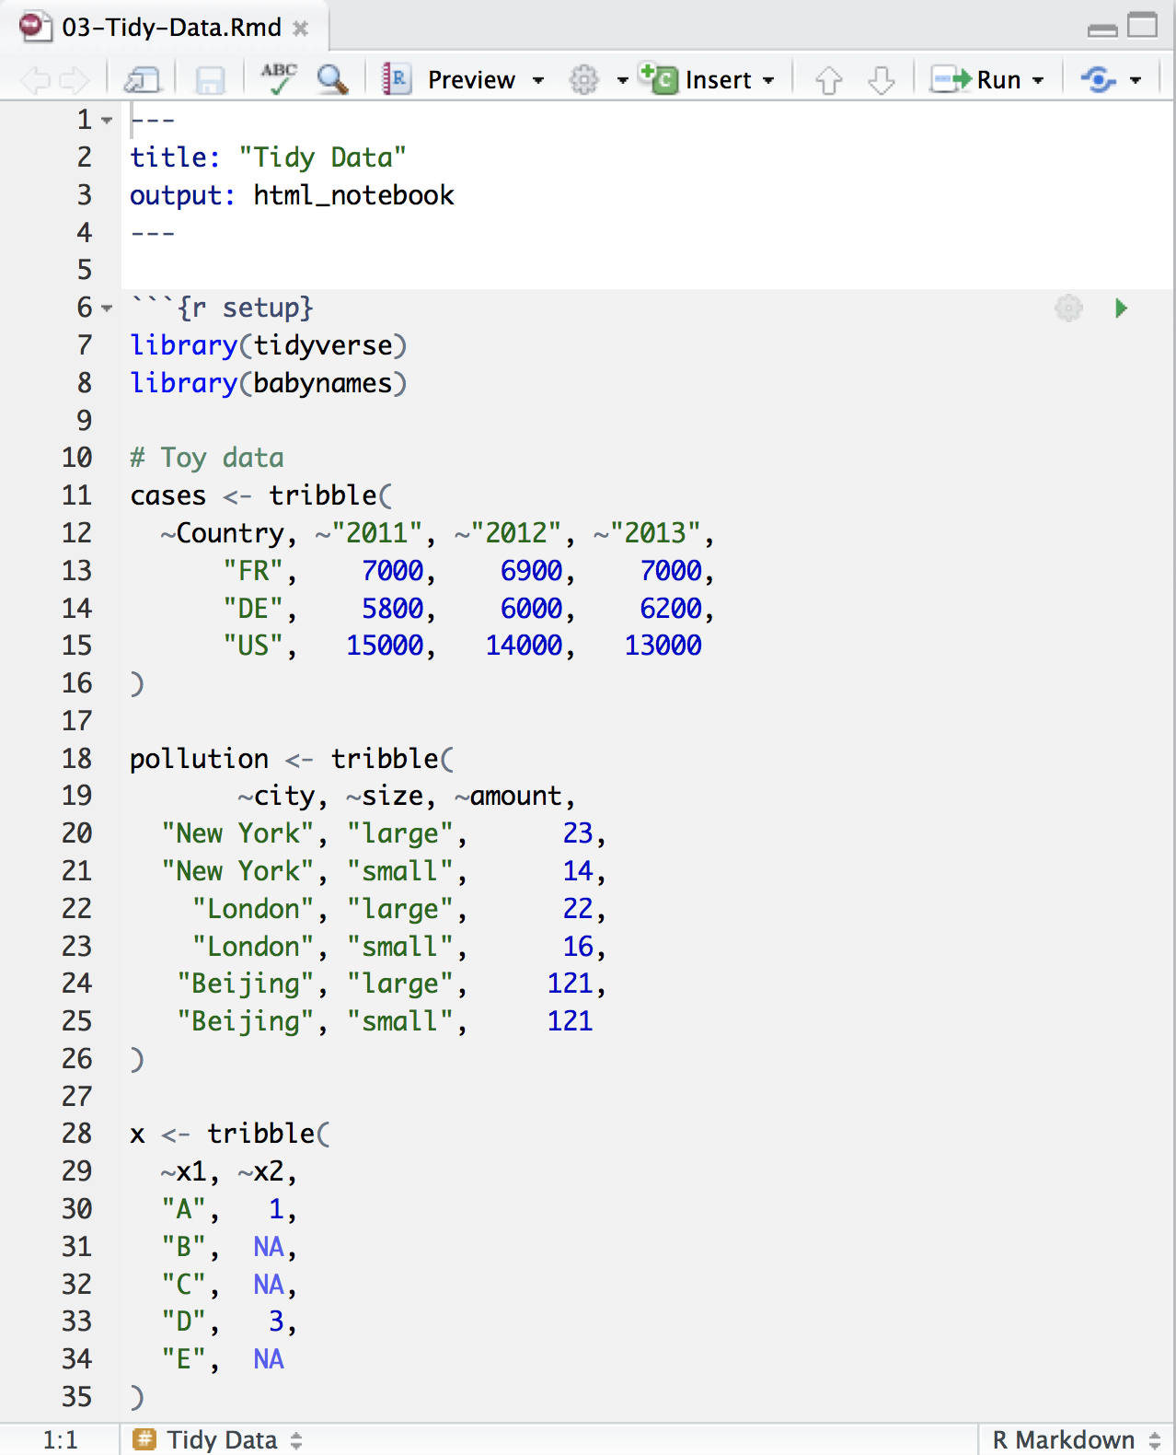
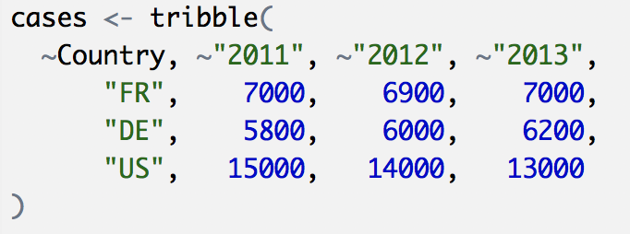
Toy data
CC BY-SA RStudio

Slide 17
Quiz
What are the variables in cases?
Country | 2011 | 2012 | 2013
FR | 7000 | 6900 | 7000
DE | 5800 | 6000 | 6200
US | 15000 | 14000 | 13000

Slide 18
Quiz
What are the variables in cases?
Country | 2011 | 2012 | 2013
FR | 7000 | 6900 | 7000
DE | 5800 | 6000 | 6200
US | 15000 | 14000 | 13000
Country
Year
Count

Slide 19
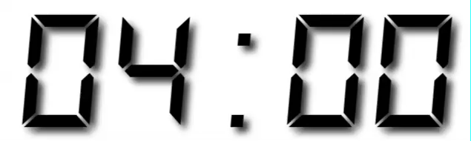
Your Turn 1
On a sheet of paper, draw how the cases data set would look if it had the same values grouped into three columns: country, year, n
Country | 2011 | 2012 | 2013
FR | 7000 | 6900 | 7000
DE | 5800 | 6000 | 6200
US | 15000 | 14000 | 13000

Slide 20
Country | 2011 | 2012 | 2013
FR | 7000 | 6900 | 7000
DE | 5800 | 6000 | 6200
US | 15000 | 14000 | 13000
CC BY-SA RStudio

Slide 21
Country | 2011 | 2012 | 2013
FR | 7000 | 6900 | 7000
DE | 5800 | 6000 | 6200
US | 15000 | 14000 | 13000
Country | Year | n
FR | 2011 | 7000
DE | 2011 | 5800
US | 2011 | 15000
FR | 2012 | 6900
DE | 2012 | 6000
US | 2012 | 14000
FR | 2013 | 7000
DE | 2013 | 6200
US | 2013 | 13000
CC BY-SA RStudio

Slide 22
Country | 2011 | 2012 | 2013
FR | 7000 | 6900 | 7000
DE | 5800 | 6000 | 6200
US | 15000 | 14000 | 13000
Country | Year | n
FR | 2011 | 7000
DE | 2011 | 5800
US | 2011 | 15000
FR | 2012 | 6900
DE | 2012 | 6000
US | 2012 | 14000
FR | 2013 | 7000
DE | 2013 | 6200
US | 2013 | 13000
CC BY-SA RStudio

Slide 23
Country | 2011 | 2012 | 2013
FR | 7000 | 6900 | 7000
DE | 5800 | 6000 | 6200
US | 15000 | 14000 | 13000
Country | Year | n
FR | 2011 | 7000
DE | 2011 | 5800
US | 2011 | 15000
FR | 2012 | 6900
DE | 2012 | 6000
US | 2012 | 14000
FR | 2013 | 7000
DE | 2013 | 6200
US | 2013 | 13000
CC BY-SA RStudio

Slide 24
Country | 2011 | 2012 | 2013
FR | 7000 | 6900 | 7000
DE | 5800 | 6000 | 6200
US | 15000 | 14000 | 13000
Country | Year | n
FR | 2011 | 7000
DE | 2011 | 5800
US | 2011 | 15000
FR | 2012 | 6900
DE | 2012 | 6000
US | 2012 | 14000
FR | 2013 | 7000
DE | 2013 | 6200
US | 2013 | 13000
CC BY-SA RStudio

Slide 25
Country | 2011 | 2012 | 2013
FR | 7000 | 6900 | 7000
DE | 5800 | 6000 | 6200
US | 15000 | 14000 | 13000
Country | Year | n
FR | 2011 | 7000
DE | 2011 | 5800
US | 2011 | 15000
FR | 2012 | 6900
DE | 2012 | 6000
US | 2012 | 14000
FR | 2013 | 7000
DE | 2013 | 6200
US | 2013 | 13000
CC BY-SA RStudio

Slide 26
Country | 2011 | 2012 | 2013
FR | 7000 | 6900 | 7000
DE | 5800 | 6000 | 6200
US | 15000 | 14000 | 13000
Country | Year | n
FR | 2011 | 7000
DE | 2011 | 5800
US | 2011 | 15000
FR | 2012 | 6900
DE | 2012 | 6000
US | 2012 | 14000
FR | 2013 | 7000
DE | 2013 | 6200
US | 2013 | 13000
CC BY-SA RStudio

Slide 27
Country | 2011 | 2012 | 2013
FR | 7000 | 6900 | 7000
DE | 5800 | 6000 | 6200
US | 15000 | 14000 | 13000
Country | Year | n
FR | 2011 | 7000
DE | 2011 | 5800
US | 2011 | 15000
FR | 2012 | 6900
DE | 2012 | 6000
US | 2012 | 14000
FR | 2013 | 7000
DE | 2013 | 6200
US | 2013 | 13000
CC BY-SA RStudio

Slide 28
Country | 2011 | 2012 | 2013
FR | 7000 | 6900 | 7000
DE | 5800 | 6000 | 6200
US | 15000 | 14000 | 13000
Country | Year | n
FR | 2011 | 7000
DE | 2011 | 5800
US | 2011 | 15000
FR | 2012 | 6900
DE | 2012 | 6000
US | 2012 | 14000
FR | 2013 | 7000
DE | 2013 | 6200
US | 2013 | 13000
CC BY-SA RStudio

Slide 29
Country | 2011 | 2012 | 2013
FR | 7000 | 6900 | 7000
DE | 5800 | 6000 | 6200
US | 15000 | 14000 | 13000
Country | Year | n
FR | 2011 | 7000
DE | 2011 | 5800
US | 2011 | 15000
FR | 2012 | 6900
DE | 2012 | 6000
US | 2012 | 14000
FR | 2013 | 7000
DE | 2013 | 6200
US | 2013 | 13000
CC BY-SA RStudio

Slide 30
Country | 2011 | 2012 | 2013
FR | 7000 | 6900 | 7000
DE | 5800 | 6000 | 6200
US | 15000 | 14000 | 13000
Country | Year | n
FR | 2011 | 7000
DE | 2011 | 5800
US | 2011 | 15000
FR | 2012 | 6900
DE | 2012 | 6000
US | 2012 | 14000
FR | 2013 | 7000
DE | 2013 | 6200
US | 2013 | 13000
CC BY-SA RStudio

Slide 31
Country | 2011 | 2012 | 2013
FR | 7000 | 6900 | 7000
DE | 5800 | 6000 | 6200
US | 15000 | 14000 | 13000
Country | Year | n
FR | 2011 | 7000
DE | 2011 | 5800
US | 2011 | 15000
FR | 2012 | 6900
DE | 2012 | 6000
US | 2012 | 14000
FR | 2013 | 7000
DE | 2013 | 6200
US | 2013 | 13000
CC BY-SA RStudio

Slide 32
Country | 2011 | 2012 | 2013
FR | 7000 | 6900 | 7000
DE | 5800 | 6000 | 6200
US | 15000 | 14000 | 13000
Country | Year | n
FR | 2011 | 7000
DE | 2011 | 5800
US | 2011 | 15000
FR | 2012 | 6900
DE | 2012 | 6000
US | 2012 | 14000
FR | 2013 | 7000
DE | 2013 | 6200
US | 2013 | 13000
pivot_longer()
CC BY-SA RStudio

Slide 33
1
2
Country | 2011 | 2012 | 2013
FR | 7000 | 6900 | 7000
DE | 5800 | 6000 | 6200
US | 15000 | 14000 | 13000
Country | Year | n
FR | 2011 | 7000
DE | 2011 | 5800
US | 2011 | 15000
FR | 2012 | 6900
DE | 2012 | 6000
US | 2012 | 14000
FR | 2013 | 7000
DE | 2013 | 6200
US | 2013 | 13000
CC BY-SA RStudio

Slide 34
names_to (former column names)
Country | 2011 | 2012 | 2013
FR | 7000 | 6900 | 7000
DE | 5800 | 6000 | 6200
US | 15000 | 14000 | 13000
Country | Year | n
FR | 2011 | 7000
DE | 2011 | 5800
US | 2011 | 15000
FR | 2012 | 6900
DE | 2012 | 6000
US | 2012 | 14000
FR | 2013 | 7000
DE | 2013 | 6200
US | 2013 | 13000
CC BY-SA RStudio

Slide 35
values_to (former cells)
Country | 2011 | 2012 | 2013
FR | 7000 | 6900 | 7000
DE | 5800 | 6000 | 6200
US | 15000 | 14000 | 13000
Country | Year | n
FR | 2011 | 7000
DE | 2011 | 5800
US | 2011 | 15000
FR | 2012 | 6900
DE | 2012 | 6000
US | 2012 | 14000
FR | 2013 | 7000
DE | 2013 | 6200
US | 2013 | 13000
CC BY-SA RStudio

Slide 36
pivot_longer()
cases %>% pivot_longer(cols = 2:4, names_to = "year", values_to = "n")
data frame to reshape
numeric indices of columns to collapse
(or names)
name of the new key column
(a character string)
name of the new value column
(a character string)

Slide 37
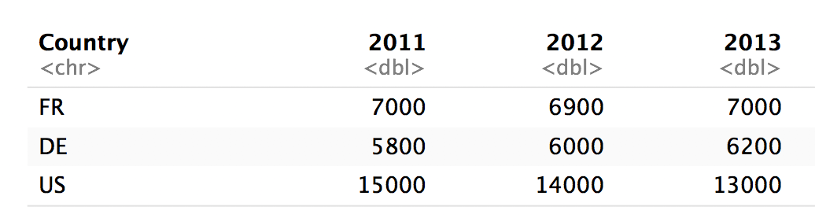
pivot_longer()
cases %>% pivot_longer(2:4, "year", "n")
numeric indices
2
3
4

Slide 38
pivot_longer()
cases %>% pivot_longer(c("2011", "2012", "2013"), "year", "n")
names
2011
2012
2013

Slide 39
pivot_longer()
cases %>% pivot_longer(-Country, "year","n")
Everything except…
Not Country
Not Country
Not Country

Slide 40
pivot_longer()
cases %>% pivot_longer(2:4, "year", "n")
cases %>% pivot_longer(c("2011", "2012", "2013"), "year", "n")
cases %>% pivot_longer(starts_with("201"), "year", "n")
cases %>% pivot_longer(-Country, "year","n")

Slide 41
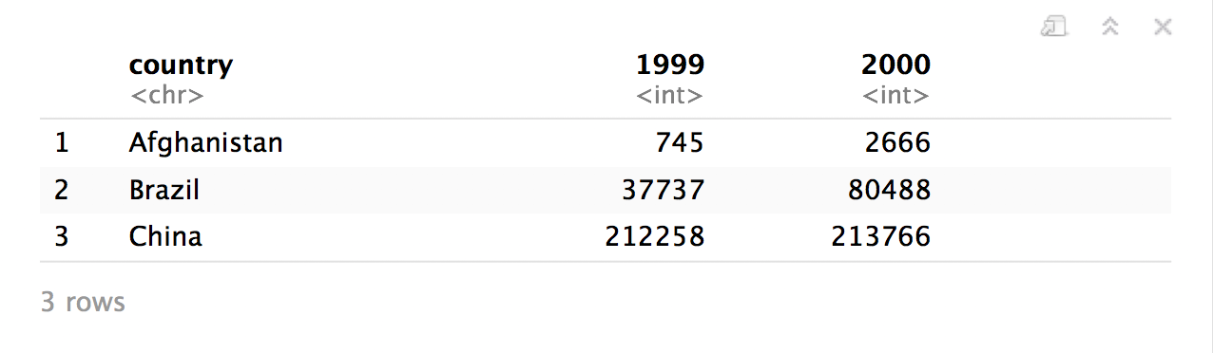
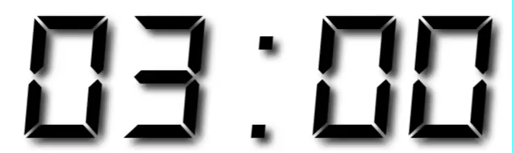
Your Turn 2
Use pivot_longer() to reorganize table4a into three columns: country, year, and cases.
Notes:
table4a is a built-in dataset of tuberculosis cases for 3 countries; subsetted from World Health Organization data (?table4a for details)

Slide 42
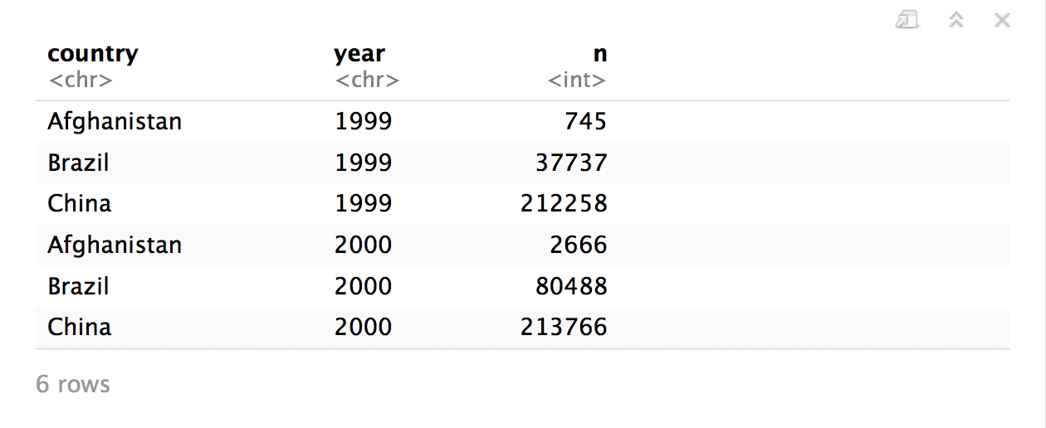
table4a %>%
pivot_longer(cols = 2:3, names_to = "year", values_to = "n")

Slide 43
pivot_wider()

Slide 44
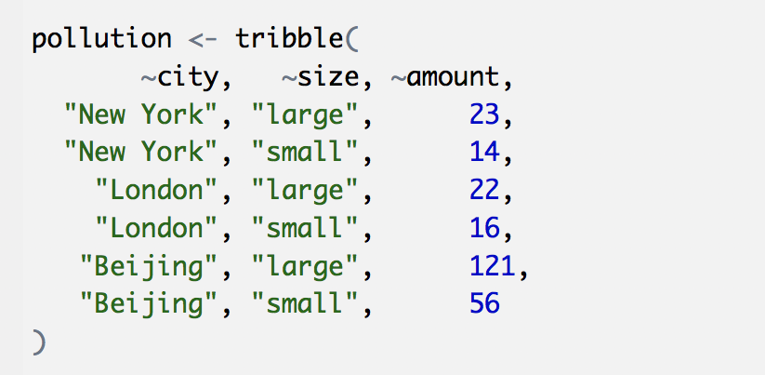
Toy data
CC BY-SA RStudio

Slide 45
Quiz
What are the variables in pollution?
city | particle size | amount (µg/m³)
New York | large | 23
New York | small | 14
London | large | 22
London | small | 16
Beijing | large | 121
Beijing | small | 56

Slide 46

Quiz
What are the variables in pollution?
city | particle size | amount (µg/m³)
New York | large | 23
New York | small | 14
London | large | 22
London | small | 16
Beijing | large | 121
Beijing | small | 56
City
Amount of large particulate
Amount of small particulate

Slide 47
Your Turn 3
On a sheet of paper, draw how this data set would look if it had the same values grouped into three columns: city, large, small
city | size | amount
New York | large | 23
New York | small | 14
London | large | 22
London | small | 16
Beijing | large | 121
Beijing | small | 56

Slide 48
city | size | amount
New York | large | 23
New York | small | 14
London | large | 22
London | small | 16
Beijing | large | 121
Beijing | small | 56
CC BY-SA RStudio

Slide 49
city | size | amount
New York | large | 23
New York | small | 14
London | large | 22
London | small | 16
Beijing | large | 121
Beijing | small | 56
city | large | small
New York | 23 | 14
London | 22 | 16
Beijing | 121 | 56
CC BY-SA RStudio

Slide 50
city | size | amount
New York | large | 23
New York | small | 14
London | large | 22
London | small | 16
Beijing | large | 121
Beijing | small | 56
city | large | small
New York | 23 | 14
London | 22 | 16
Beijing | 121 | 56
CC BY-SA RStudio

Slide 51
city | size | amount
New York | large | 23
New York | small | 14
London | large | 22
London | small | 16
Beijing | large | 121
Beijing | small | 56
city | large | small
New York | 23 | 14
London | 22 | 16
Beijing | 121 | 56
CC BY-SA RStudio

Slide 52
city | size | amount
New York | large | 23
New York | small | 14
London | large | 22
London | small | 16
Beijing | large | 121
Beijing | small | 56
city | large | small
New York | 23 | 14
London | 22 | 16
Beijing | 121 | 56
CC BY-SA RStudio

Slide 53
city | size | amount
New York | large | 23
New York | small | 14
London | large | 22
London | small | 16
Beijing | large | 121
Beijing | small | 56
city | large | small
New York | 23 | 14
London | 22 | 16
Beijing | 121 | 56
CC BY-SA RStudio

Slide 54
city | size | amount
New York | large | 23
New York | small | 14
London | large | 22
London | small | 16
Beijing | large | 121
Beijing | small | 56
city | large | small
New York | 23 | 14
London | 22 | 16
Beijing | 121 | 56
CC BY-SA RStudio

Slide 55
city | size | amount
New York | large | 23
New York | small | 14
London | large | 22
London | small | 16
Beijing | large | 121
Beijing | small | 56
city | large | small
New York | 23 | 14
London | 22 | 16
Beijing | 121 | 56
CC BY-SA RStudio

Slide 56
city | size | amount
New York | large | 23
New York | small | 14
London | large | 22
London | small | 16
Beijing | large | 121
Beijing | small | 56
city | large | small
New York | 23 | 14
London | 22 | 16
Beijing | 121 | 56
CC BY-SA RStudio

Slide 57
city | size | amount
New York | large | 23
New York | small | 14
London | large | 22
London | small | 16
Beijing | large | 121
Beijing | small | 56
pivot_wider()
city | large | small
New York | 23 | 14
London | 22 | 16
Beijing | 121 | 56
CC BY-SA RStudio

Slide 58
1
2
city | size | amount
New York | large | 23
New York | small | 14
London | large | 22
London | small | 16
Beijing | large | 121
Beijing | small | 56
city | large | small
New York | 23 | 14
London | 22 | 16
Beijing | 121 | 56
CC BY-SA RStudio

Slide 59
names_from (new column names)
city | size | amount
New York | large | 23
New York | small | 14
London | large | 22
London | small | 16
Beijing | large | 121
Beijing | small | 56
city | large | small
New York | 23 | 14
London | 22 | 16
Beijing | 121 | 56
CC BY-SA RStudio

Slide 60
values_from (new cells)
city | size | amount
New York | large | 23
New York | small | 14
London | large | 22
London | small | 16
Beijing | large | 121
Beijing | small | 56
city | large | small
New York | 23 | 14
London | 22 | 16
Beijing | 121 | 56
CC BY-SA RStudio

Slide 61
pivot_wider()
pollution %>% pivot_wider(names_from = size, values_from = amount)
data frame to reshape
column to use for keys (becomes new
column names)
column to use for values
(becomes new
column cells)

Slide 62
pollution %>% pivot_wider(names_from = size, values_from = amount)
city | size | amount
New York | large | 23
New York | small | 14
London | large | 22
London | small | 16
Beijing | large | 121
Beijing | small | 56
city | large | small
New York | 23 | 14
London | 22 | 16
Beijing | 121 | 56
CC BY-SA RStudio

Slide 63
Your Turn 4
Use pivot_wider() to reorganize table2 into four columns: country, year, cases, and population.

Slide 64
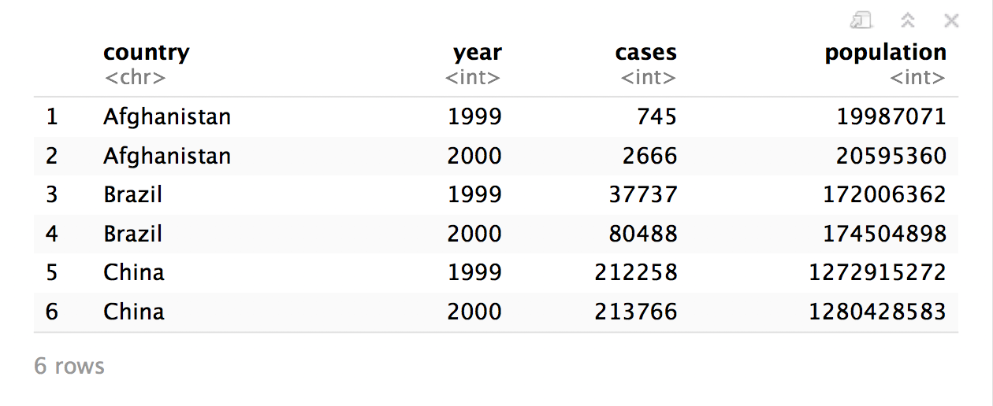
table2 %>%
pivot_wider(names_from = type, values_from = count)

Slide 66
Section

Slide 67
Code
HTTP Verb
HTTP version
URL path
URL path
GET /resources/webinars/ HTTP/1.1
Host: www.rstudio.com
User-Agent: libcurl/7.43.0 r-curl/2.1 httr/1.2.1
Accept-Encoding: gzip, deflate
Accept: application/json, text/xml, application/xml, */*
CC BY-SA RStudio

Slide 68
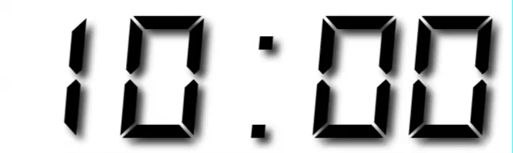
Your Turn
Open R. Then download the packages that we will use today by running the following code.

Slide 69
Sub section

Slide 70
CC BY-SA RStudio

Slide 71









Technical Diagram
Shiny Server Pro
Production
Data Scientists
RStudio IDE
End Users
Web Browsers
Sticky Load Balancer
Staging
Data Stores
File Share
Data Mart

Slide 72





















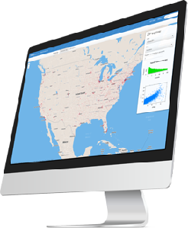
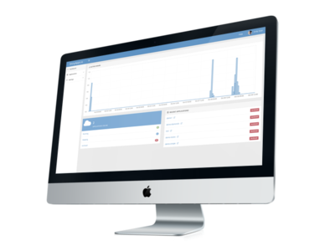



















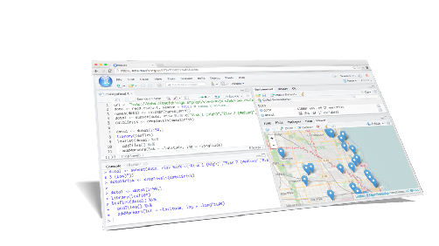
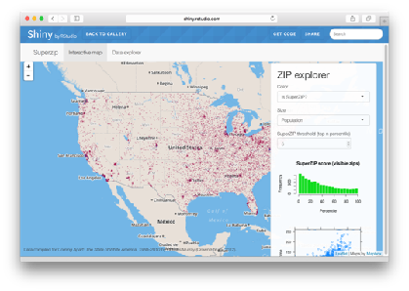






Icons
Hardware
Software
Packages
Architecture
dplyr
0.4
+
SYSTEM LIBRARY

Slide 73


Hardware
Software
Packages
Architecture

rvest

